Slide 1
Research Workshop
— by Liang Xiao

Slide 2

Self-Introduction
Li ang Xiao
Major in ME, Senior Student
Research experience:
1. “Rheological behavior of block copolymer in electric field” instructed by Professor Yunlong Guo.
2. “Multi-leg transformable wheel robot” instructed by Professor Jaehyung Ju.

Slide 3
The most convenient approach
Search in the official website of JI.
Find research fields that you are interested in.
Contact with the professor who has the most “suitable” research projects.
Be confident and active.

Slide 4
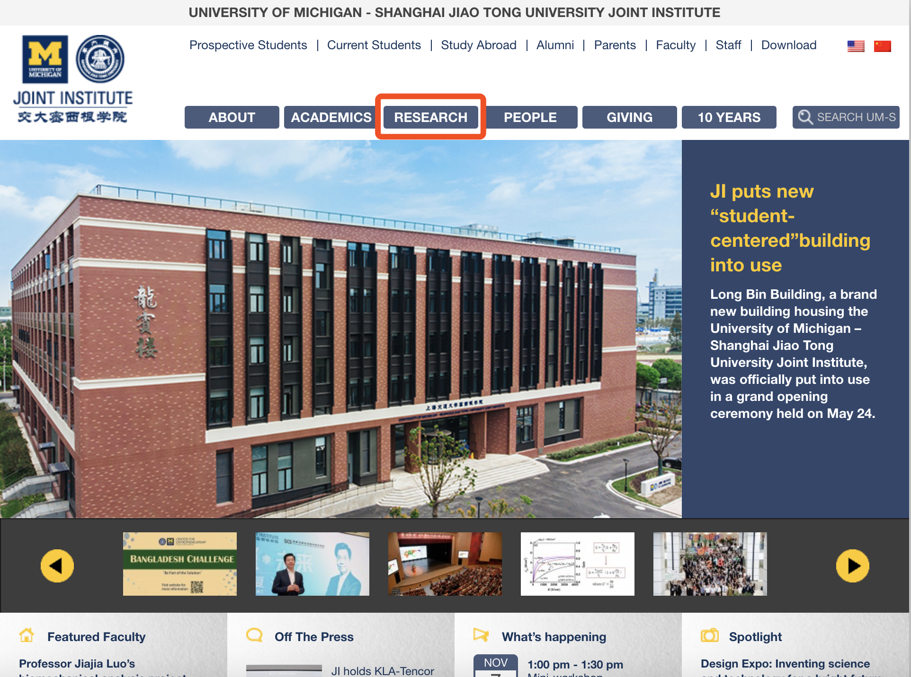
The most convenient approach

Slide 5
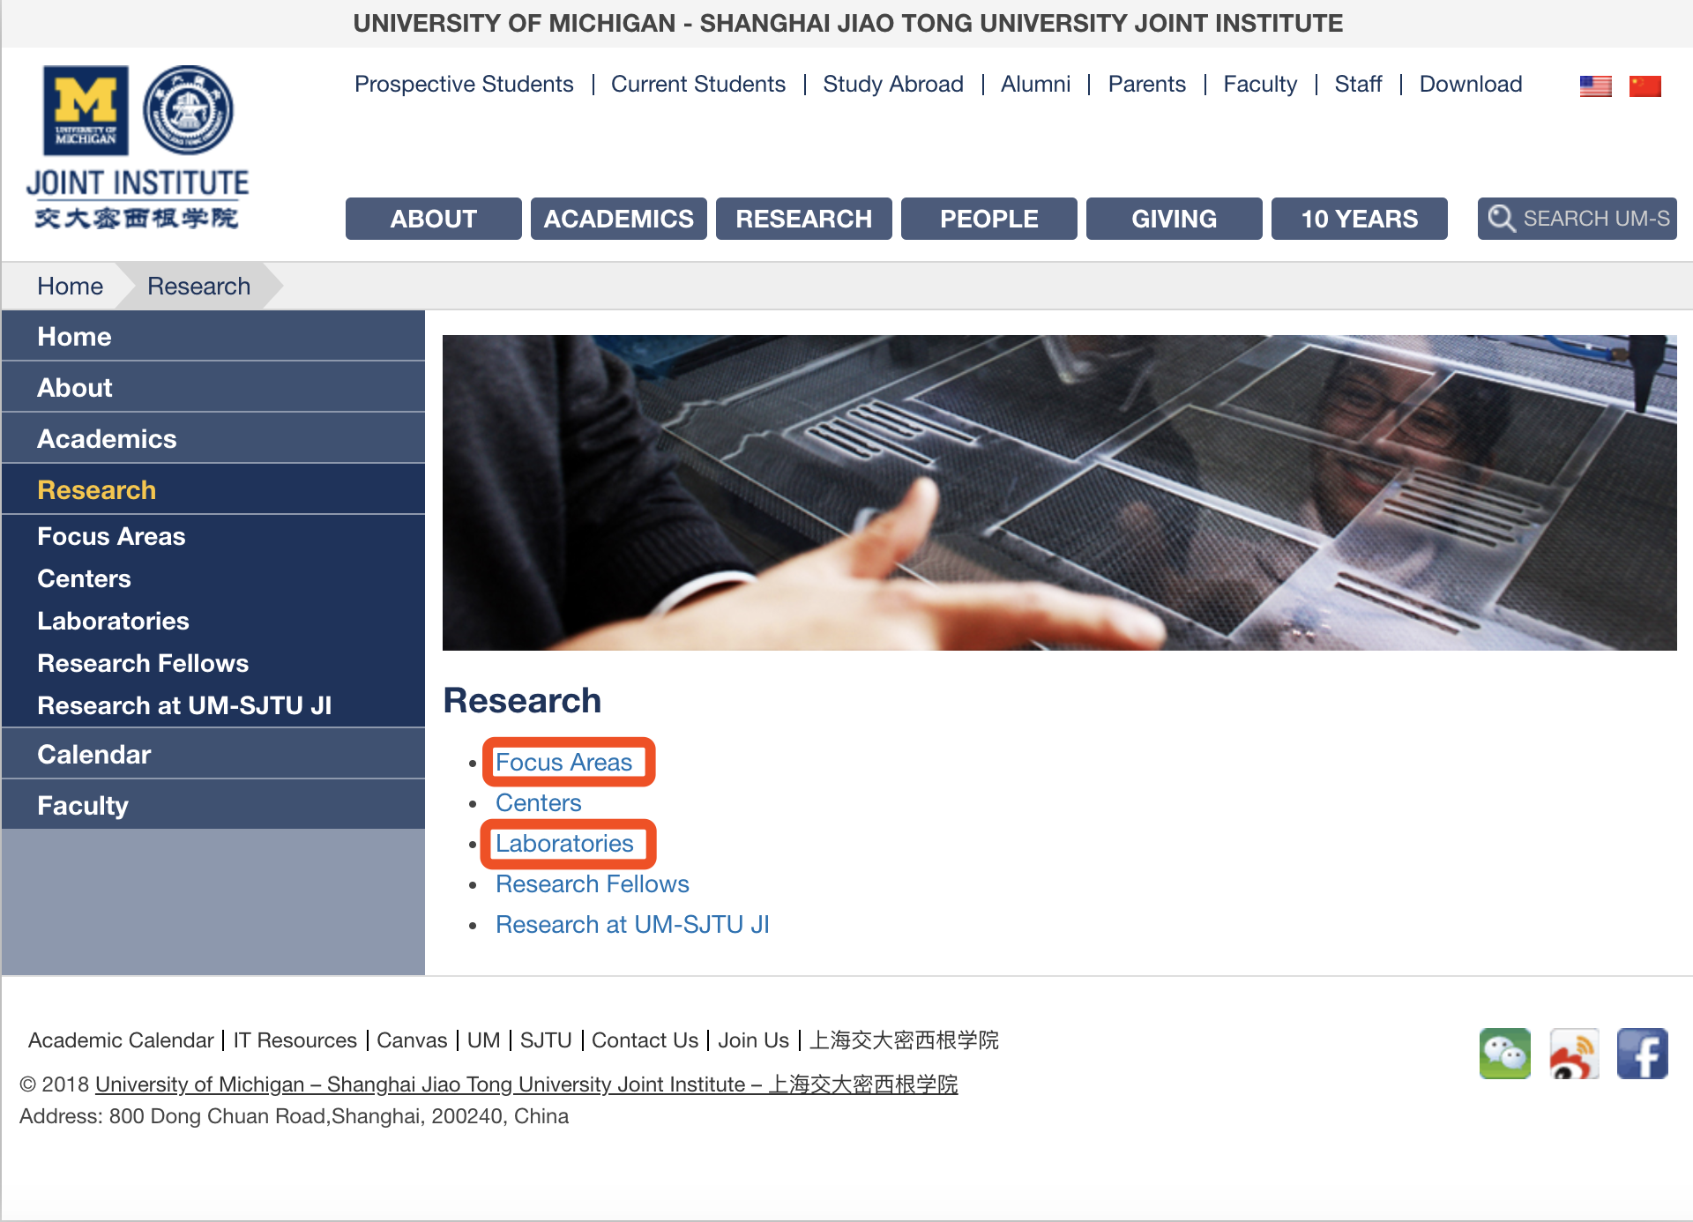

Slide 6
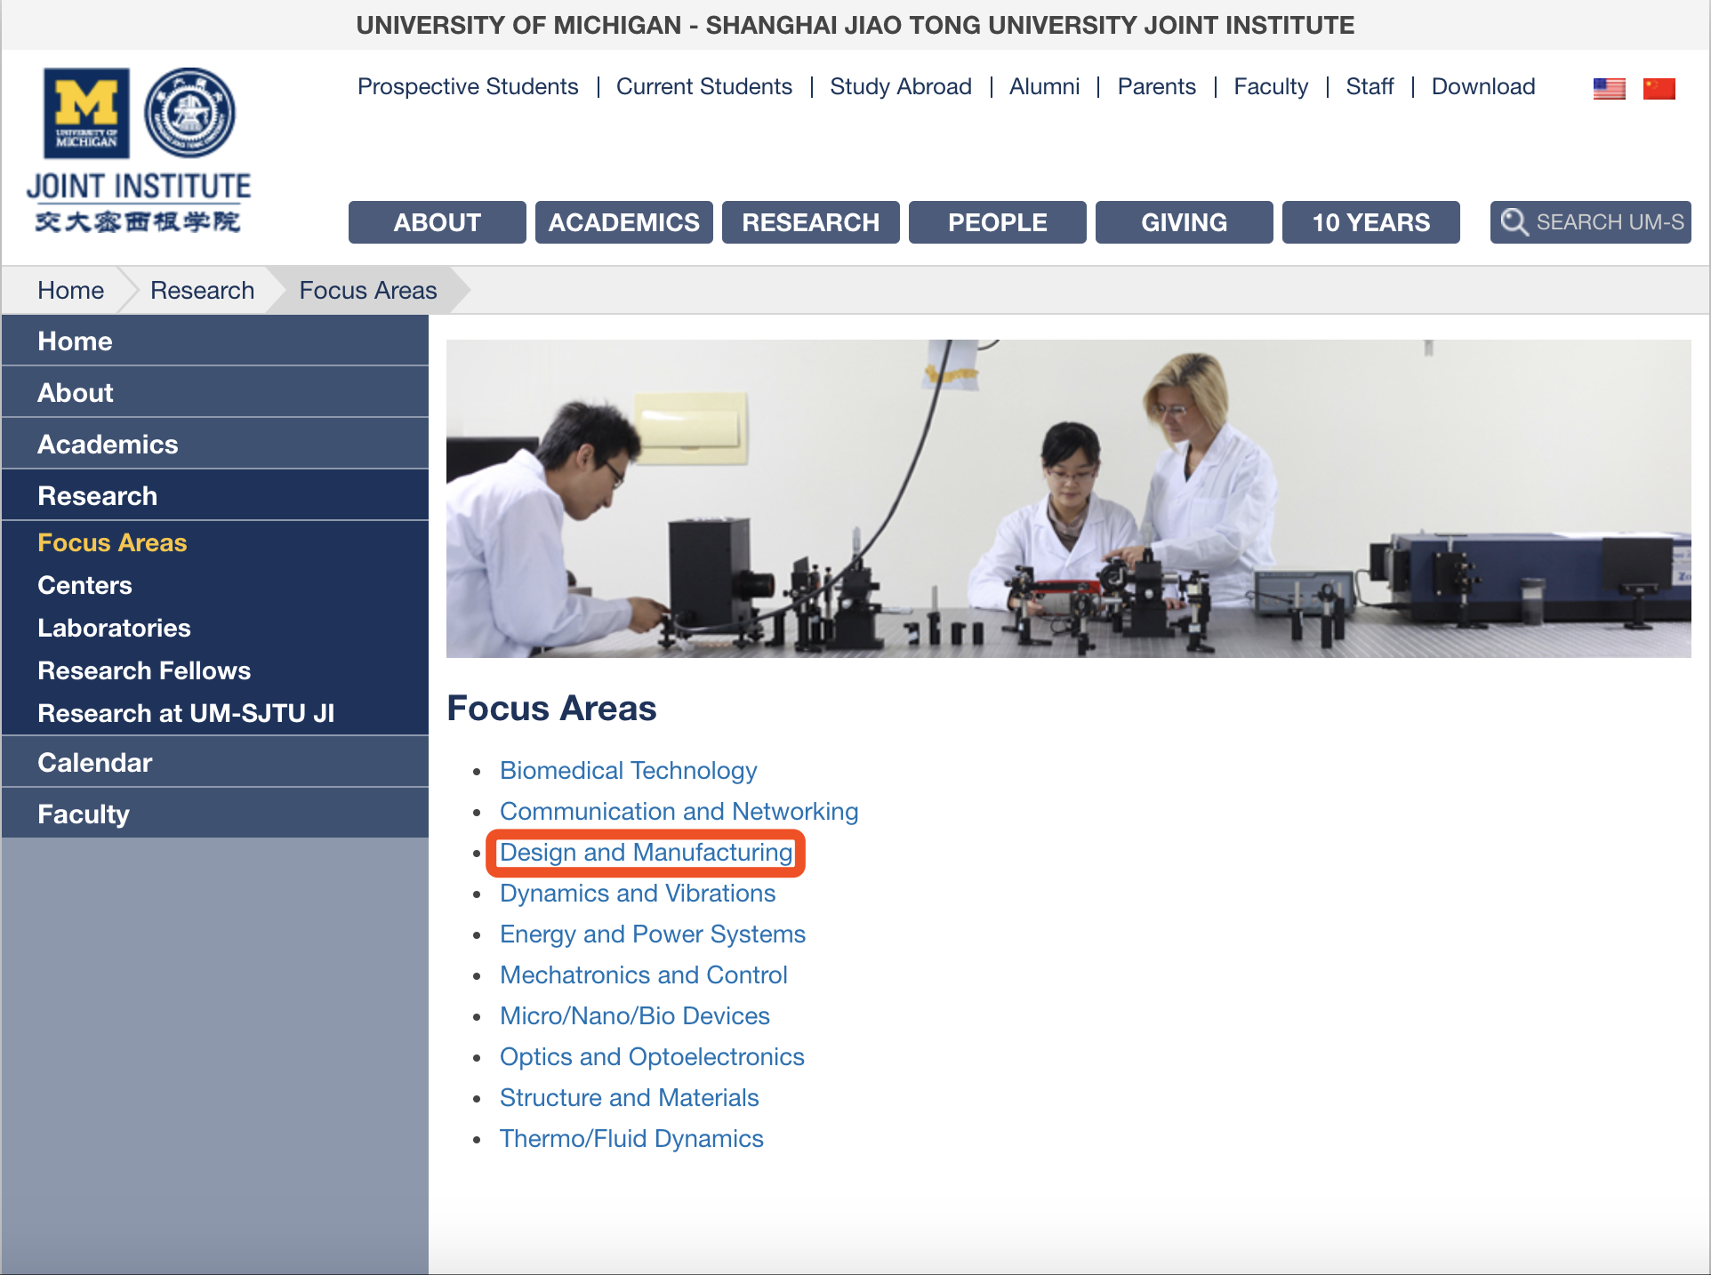

Slide 7
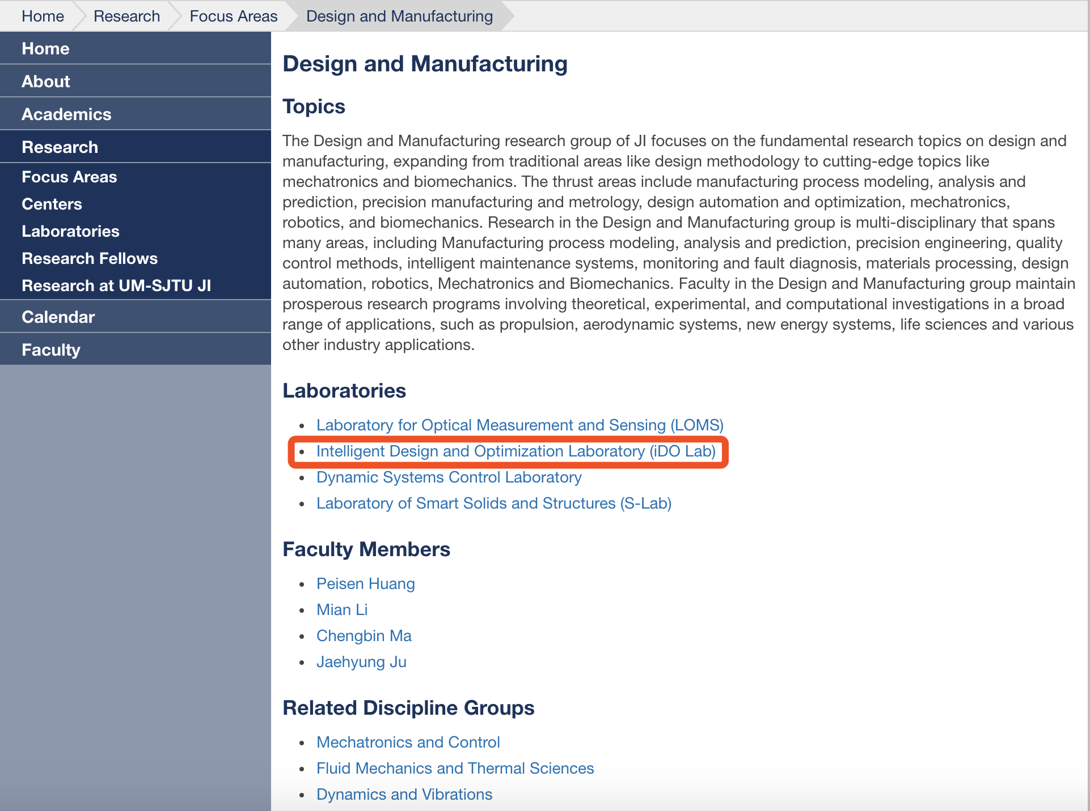

Slide 8
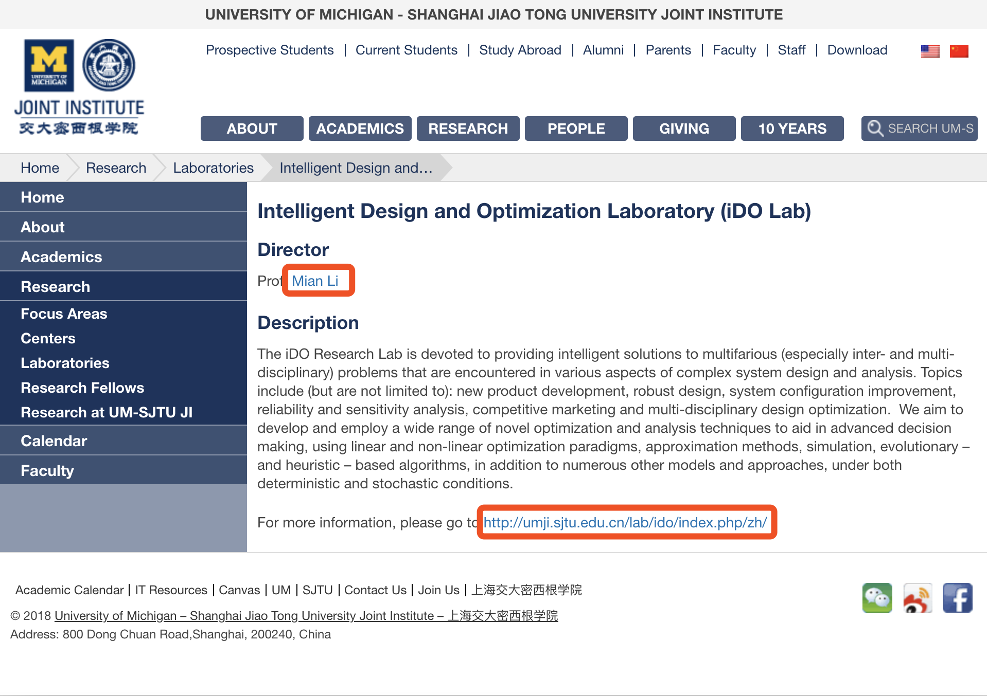

Slide 9
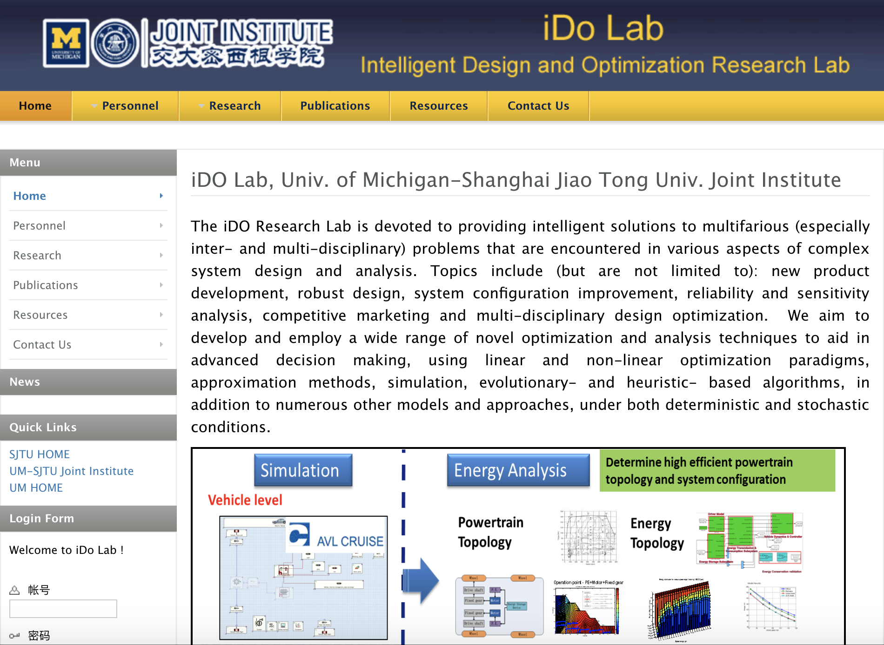

Slide 10
Different forms of Research
VM/VE490：3 credits, weekly meeting, final report
IPP,PRP: long time, several presentations, form team with others (maybe not JIers).
Research assistant: no credit, weekly meeting

Slide 11
Other approaches
JI Career：助研岗位，IPP
密院新青年公众号：助研岗位
Canvas： VM/VE490 Courses
教学信息服务网：IPP, PRP 报名

Slide 12
ME Concentration
Design and Manufacturing
Control, System and Robotics
Computations in fluid and solids;
Solid/Fluid Mechanics
Dynamics and Vibrations
Materials and Science
Thermal Sciences/Energy
Biomechanics
Micro/Nano Engineering
Relatively easy to find jobs;
Academia closely related to industry;
Requires knowledge from math, mechanics and CS;
Ph.D. is encouraged;
Heavy in theory;
Ph.D. is encouraged;
Heavy in research(theory, simulations or experiments);
Ph.D. is necessary;
Career path in academia is the choice for many;

Slide 13
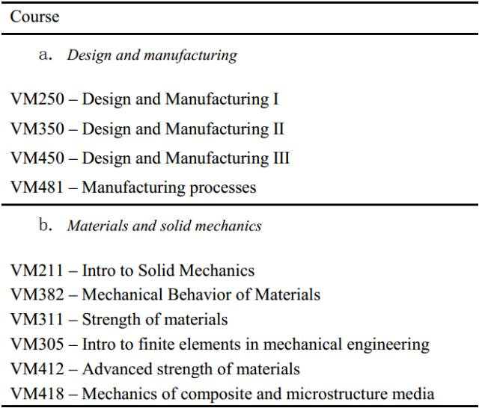
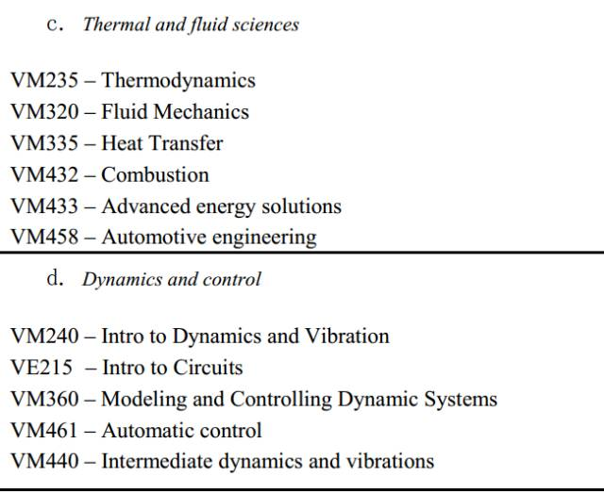
Corresponding courses

Slide 14
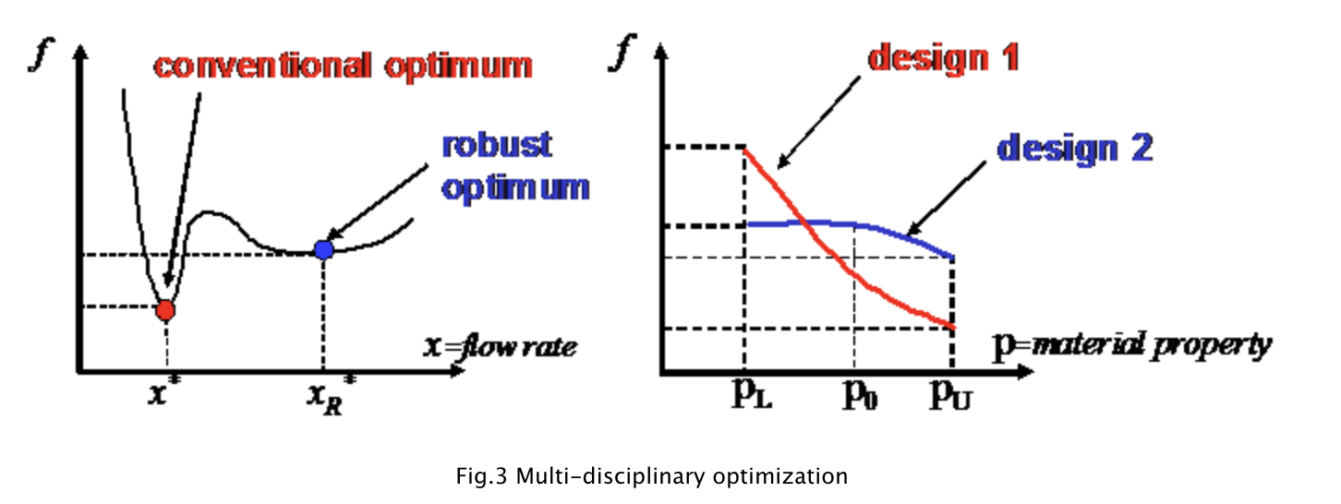
Design and manufacturing
Professor Mian Li
Intelligent Design and Optimization Research Lab
1. Design and optimization of complex engineering systems 2. Deterministic and stochastic (robust/reliability) optimization 3. Sensitivity analysis, uncertainty analysis 4. Evolutionary/classical multi-objective and multi-disciplinary optimization 5. Reduced order modeling, approximation (Design of Experiments, metamodeling)

Slide 15
Design and manufacturing
Professor Mian Li
Intelligent Design and Optimization Research Lab
Recent research work:
IPP:无人智能赛车轨迹规划和运动控制
Path planning and motion control for autonomous RC car
https://mp.weixin.qq.com/s/mfw8V81wlWD0Mk-axLIIOw

Slide 16
Design and manufacturing
Professor Jaehyung Ju
Laboratory of Smart Solids and Structures
1. Design intelligent solids and structures having programmable mechanical properties by transformation of micro-architectures.
2. Soft robotics
3. 4D printing fabricating mesostructures with multi-materials, programming the material’s function with time.

Slide 17
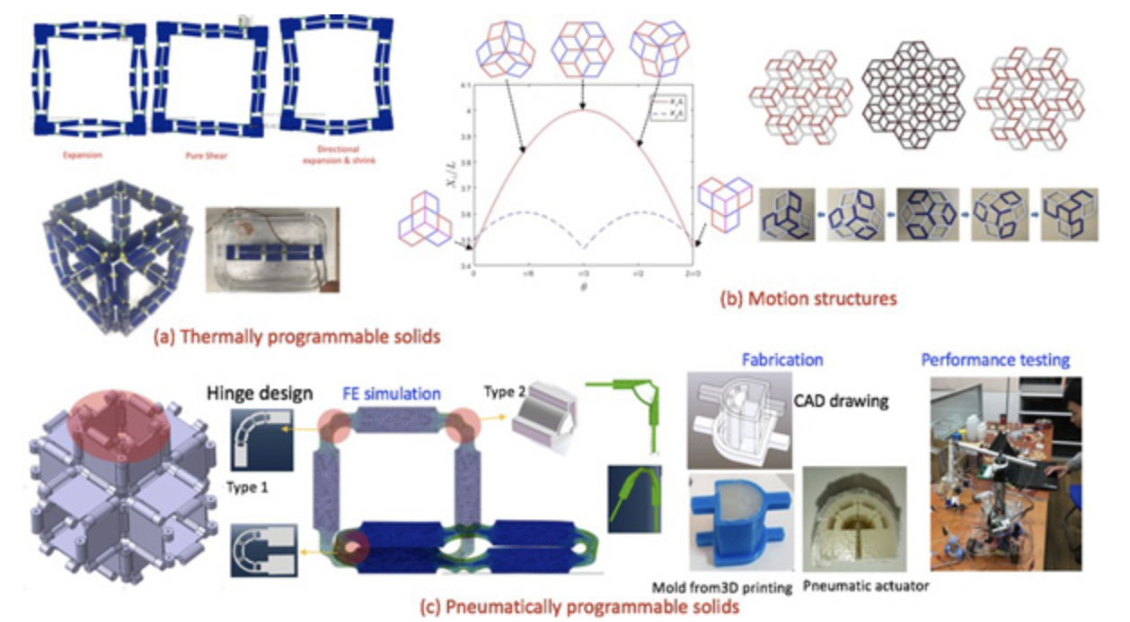
Design and manufacturing
Professor Jaehyung Ju
Laboratory of Smart Solids and Structures

Slide 18
Design and manufacturing
Other professor and laboratories:
Shane Johnson
Center for Advanced Mechanics, Material and Structure
http://umji.sjtu.edu.cn/research/labs/center-for-advanced-mechanics-materials-and-structures/

Slide 19
Materials
Professor Hong Zhu
In-silico advanced materials Design (IamD) Lab
1. Combining computational materials science, solid state physics, thermodynamics and chemistry to understand fundamental and critical materials problems in high-impact applications.
2. Applying high-throughput materials simulations, data-mining and experiment to speed up new materials development.
3. Developing new algorithm or tools for materials simulations.

Slide 20
Materials
Professor Hong Zhu
Feedback from Graduate student:
课题组研究方向主要包括：热电材料，光电材料，镁合金等，还有针对材料计算的新算法与计算工具的设计
我们组主要用第一性原理以及数据挖掘的方法探究材料的性质，以更好地理解、设计和开发新型材料。简单来说我们会用科学计算程序，在超级计算机上计算材料的能带、弹性常数、位错能等诸多与材料宏观性质联系紧密的性质。我们能够根据文献和所掌握的知识自己设计出新的结构，并通过超级计算机的辅助，来验证自己的想法。在某些情况下，我们会获得大量计算数据，并且会通过数据挖掘技术，帮助我们进行分析验证

Slide 21
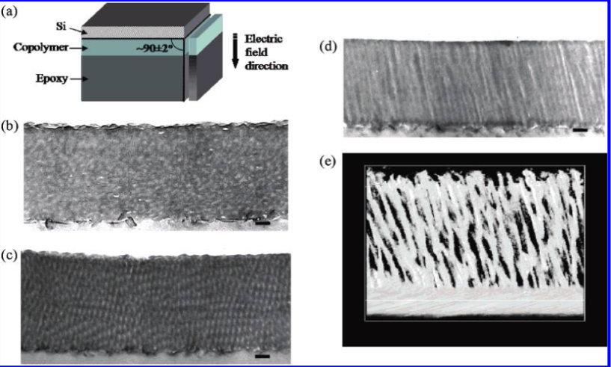
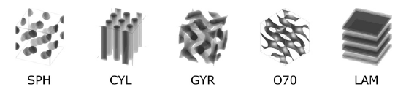
Materials
Professor Yun Long Guo
Advanced Polymeric Materials Laboratory
1. Explore the Dynamics and Thermoviscoelastic Behavior of Polymer Glasses under Nanoconfined Geometries;
2. Design and Characterization of Nanostructured Ultra-stable Polymer Films for Applications in Optics and Energy.
My experience: Rheological behavior of block copolymer in electric field

Slide 22
Materials
Other professors and Laboratories
Professor Shouhang Bo
Material- and system-level studies of solid-state materials for energy storage devices (e.g., Li-ion, Na-ion, Mg-ion and solid-state batteries)
Professor Qianli Chen:
Macromolecule materials, conductive materials，perovskite batteries
Professor Morteza Eslamian
Thin Films and Thin Film Photovoltaics
http://pv.sjtu.edu.cn/index.html

Slide 23
Solid mechanicals, Dynamics and Control
Professor Yongxing Shen
Mechanics and Computation of Evolving solids Lab http://umji.sjtu.edu.cn/~yxshen/Index.php
models and applications such as the phase field approach to fracture,
numerical simulation of hydraulic fracturing, thin shell fracture, and additive manufacturing
numerical methods such as the successive node snapping scheme, universal meshes, mapped finite element method, and discontinuous Galerkin methods

Slide 24
Solid mechanicals, Dynamics and Control
Professor Yanfeng Shen
Structural health monitoring (SHM) and self-sensing smart structures
Advanced computational mechanics for waves and vibrations
Guided waves and nonlinear ultrasonics
Multifunctional active materials and novel actuation/sensing device
Current Project: Liquid Electrode System for Mobile Active Sensing

Slide 25
Solid mechanicals, Dynamics and Control
Professor Chengbin Ma
http://umji.sjtu.edu.cn/lab/dsc/
Dynamic Systems Control Laboratory (DSC Lab)
advanced electric vehicle control systems for enhanced safety, energy efficiency, performance and riding comfort;
modeling and control of flexible mechanical systems by fractional order modeling/control;
theory and applications for resilient control systems.

Slide 26
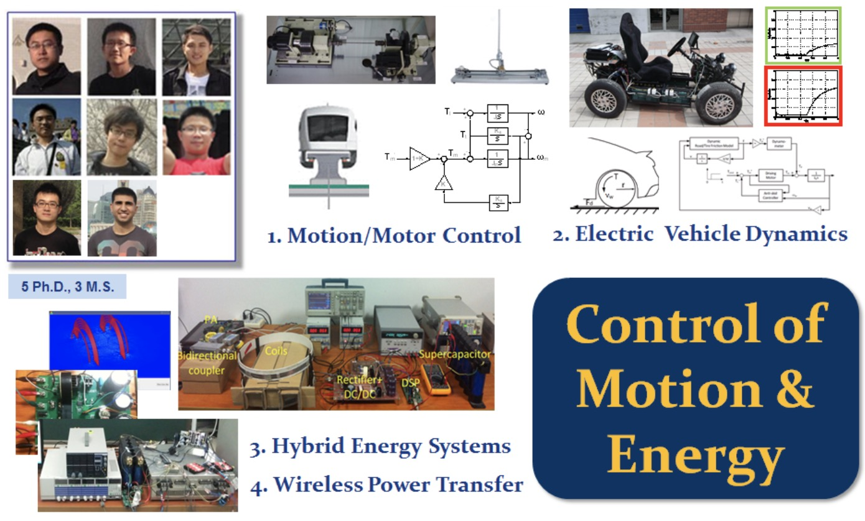
Solid mechanicals, Dynamics and Control
Professor Chengbin Ma
Dynamic Systems Control Laboratory (DSC Lab) http://umji.sjtu.edu.cn/lab/dsc/

Slide 27
Solid mechanicals, Dynamics and Control
Other professors and Laboratories
Professor Jun Zhang
System, Control, and Optimization Laboratory

Slide 28

Thermal and Fluid Sciences
Professor Hua Bao
Molecular dynamics simulation
First-principles method
Boltzmann transport equation
Heat conduction in multiscale porous media
Current Project： The electrical thermal conductivity of intrinsic semiconductor in high temperature range: a first-principles study

Slide 29
Thermal and Fluid Sciences
Professor David Hung, Professor Kwee-Yan Teh
Flow Sensing and Diagnostic Laboratory
· Fuel injection characterization
· The cycle-to-cycle variation analysis of pulsating flow of conventional fluids
·Renewable fuels in automotive applications.
Current Project： Force Measurement of Liquid Droplet Impacting on a Thin Liquid Layer （VM490 of Professor kwee-Yan Teh）

Slide 30
Thermal and Fluid Sciences
Professor David Hung
Flow Sensing and Diagnostic Laboratory
新能源燃料雾化、燃烧技术，高速多维激光燃烧诊断技术
混合动力汽车发动机技术， 电动汽车线控转向技术
自动驾驶技术优化算法和统计算法及应用
Current Project：
Vortex structure recognition and analysis:
Vortex center location, rotation direction and size.
Flow field movement prediction:
Predict flow field movement based on data of previous flow fields.

